Slide 1
Darwin and the Theory of Evolution
Gabriela Avella
1st Grade
February 2006

Slide 2
Background
Darwin’s evolution theory: Species that are the best suited to the environment survive. Those that cannot adapt die out.

Slide 3
Purpose
Can random events such as earthquakes and tornados change the chance of species to survive?

Slide 4
Hypothesis
I believe that animals that are faster have a greater chance to survive in the presence of random events.

Slide 5
Procedure
Throw a dice. Numbers on the dice represent 6 different animals, each of them with a different speed (slow, medium, fast)
  Buffalo (1) and Giraffe (2) are slow speed animals
  Zebra (3) and Dik Dik (4) are medium speed animals
  Impala (5) and Antilope (6) are fast speed animals
The dice throw represents random events in nature such as tornadoes, earthquakes, etc.

Slide 6
Procedure
Every time a number is thrown the animal that is represented by that number will advance slots as follows:
  Buffalo and Giraffe (slow speed) will advance 1 slot.
  Zebra and Dik Dik (medium speed) will advance 2 slots.
  Impala and Antilope (fast speed) will advance 3 slots.
Using a web tool “Darwin’s Tool”:
  Click on “enter dice result”. An empty box will prompt to enter a dice result.
  Throw a dice and type number in the box (1 to 6). Click OK.
  Repeat dice throw and enter number until one animal wins.
  Repeat the experiment 20 times.

Slide 7
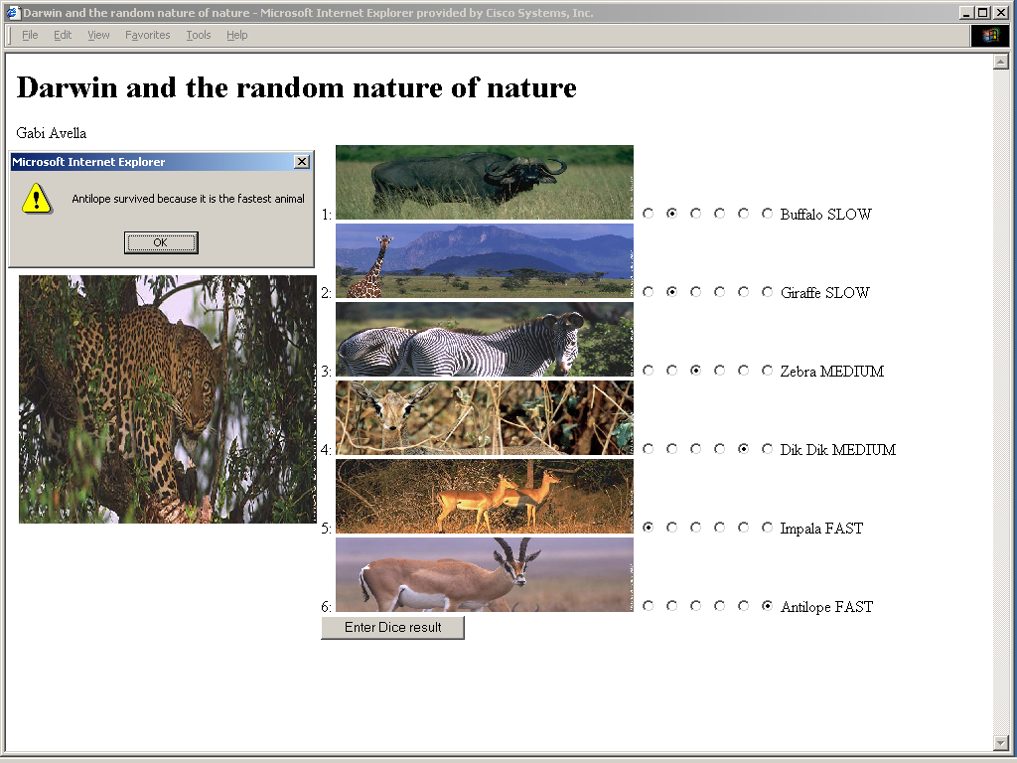
Darwin’s Tool

Slide 8
Data gathering and Results
Record the winner on a table.
Draw a chart of your results.

Slide 9
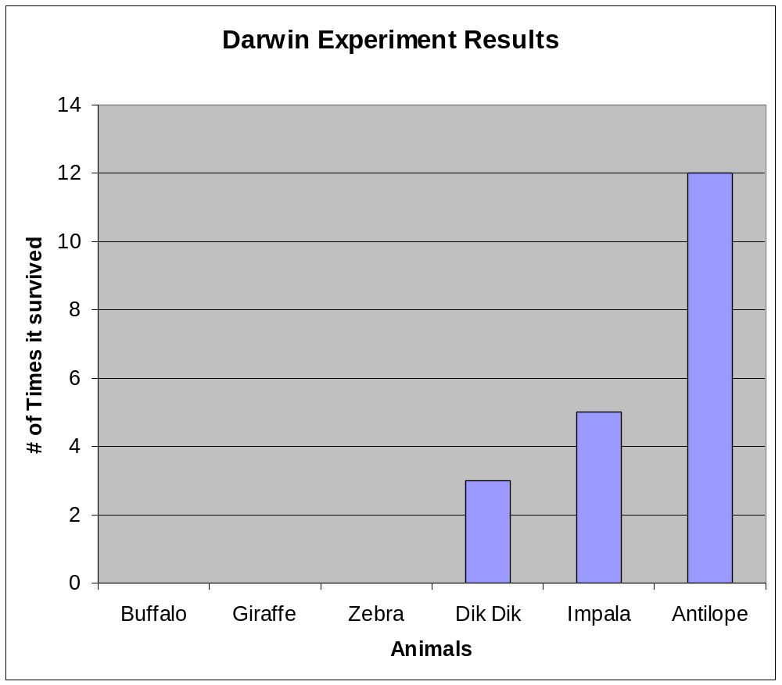
Results analysis
Buffalo | 0
Giraffe | 0
Zebra | 0
Dik Dik | 3
Impala | 5
Antilope | 12

Slide 10
Conclusion
Faster animals have a better chance to survive than slower animals in the presence of random natural events such as earthquakes, tornados, etc., because they can escape and find shelter quicker than slower animals.

